Slide 1

SPD Sports Club database
By: Darius Parker, Pierina M Logrono & Samantha Reyes

Slide 2
SPD Sports Club Introduction
SPD Sports Club is a new chain of gym facilities that have 1 gym location in each borough of NYC
Each facility has three classes per day offered at 7:00am, 12:00pm and 6:00pm.
Members can sign up for a standard plan for $50 or a premium plan for $100.
SPD is looking to expand and is considering the following factors in its decision:
Most popular classes offered at each location
Does the time a class is offered impact this?
Which facility has the most active members?
Demographics of members (e.g., age)

Slide 3
Glossary
Gym member - Members at the gym.
Gym trainer - The instructors leading the classes offered.
Check-in – In order to access the gym, members must first check in to confirm their membership is active.
Classes – The different exercise sessions offered by the gym at a designated time.
Facilities- The gyms at different locations throughout the city
Gym Plans – membership types offered to clients at different prices with different benefits/access.

Slide 4
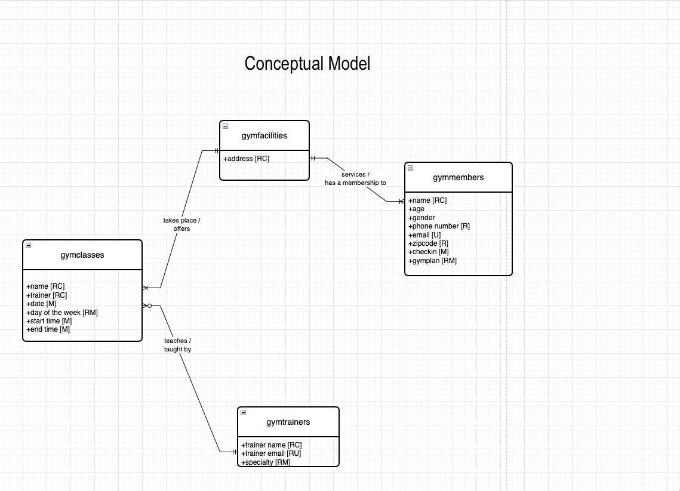
Conceptual Model

Slide 5
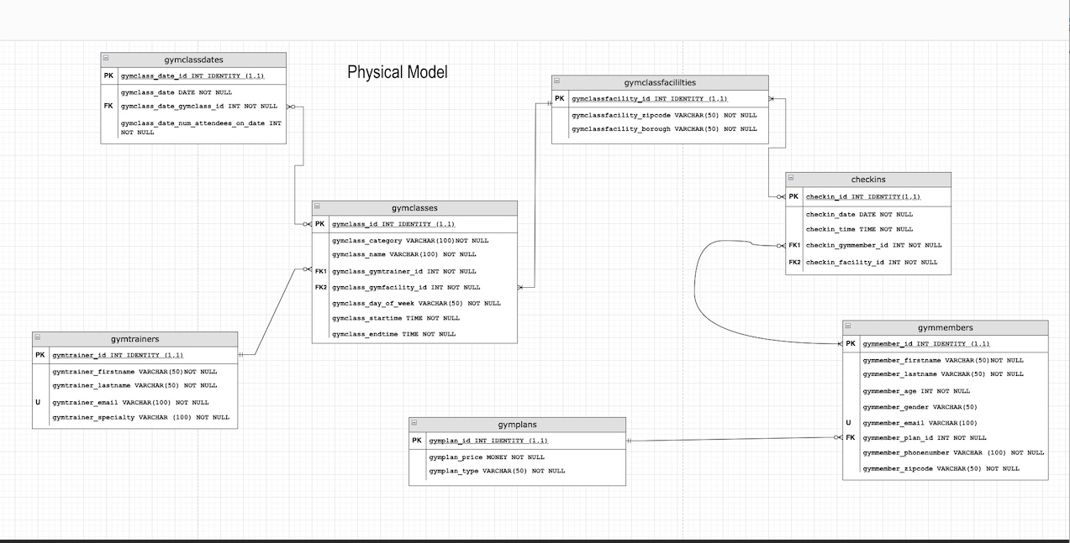
Physical Model

Slide 6
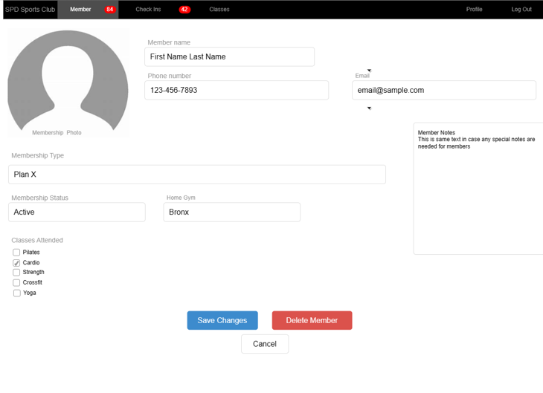
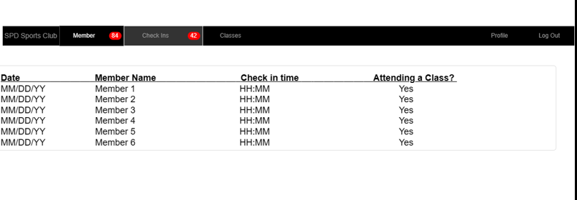
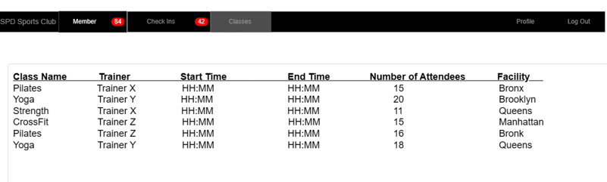
Gym Application

Slide 7
Considerations
Brooklyn has been the most popular facility
Queens has had the lowest number of check ins
Strength, yoga and cardio are the most popular classes
In the Bronx and Brooklyn, cardio are most popular
In Manhattan and Staten Island yoga and strength are more popular
Nearly an equal number of attendees for each start time.
Around an even amount of male and females at each gym
Average age across all gyms is 47

Slide 8
Conclusions
We recommend opening a new facility in Brooklyn
Invest in advertising and offer members more incentives to drive more check ins at the Queens facility
Promote offers to target age groups between 18-30
Offer more cardio, yoga and strength classes
Consider expanding gyms to offer multiple classes in one time slot

